Slide 1

Individual Project ARI5102- Data Analysis Techniques
André Attard | Master of Science in Data Science | andre.attard.17@um.edu.mt
20th June 2023
1
20th June 2023

Slide 2
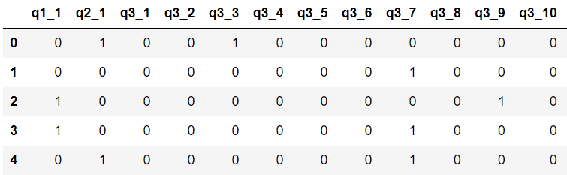
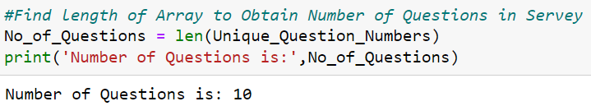
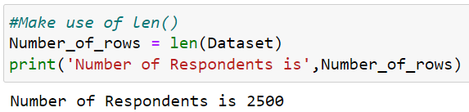
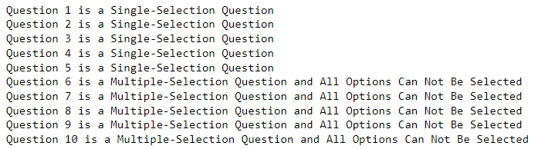
Task 1 – Initial Dataset Exploration
Each Question start with the same prefix followed by option number
Different Questions start with different initial prefixes
Each row in the dataset
corresponds to a respondent
How many Question exist in the survey?
Logic: Count the number of different
initial prefixes
How many Respondents Answered the survey?
Logic: Count the number of rows in dataset
What are the different question types based according
to their selection options?
Logic: Count the number of maximum and minimum
selections made for each question
2

Slide 3
Task 2 – Performance Metric Selection Based on Question Type
Questions 1 and 2 are Single-Selection Questions with two class labels each Binary Classification problem.
Accuracy – Percentage of correct predictions
Error Rate – Percentage of incorrect predictions
Precision – Percentage of true positive predictions out of all positive predictions made by the model
Recall – True positive rate
F1-Score – Combines Precision and Recall as one balanced metric
Questions 3, 4 and 5 are Single-Selection Questions with ten class labels each Multi-Class Classification problem.
Macro Average F1-Score – Average F1-Score treating all classes equally
Weighted Average F1-Score – Average F1-Score weighting classed by actual number of occurrences
Micro Average F1-Score – Considers total number of True Positives, False Positives and False Negatives across all classes.
Questions 6 – 10 are Multiple-Selection Questions with ten class labels each Multi-Label Classification problem.
Hamming Loss – Measures fraction of labels that are incorrectly predicted by the model.
Macro Average F1-Score
Micro Average F1-Score
3

Slide 4
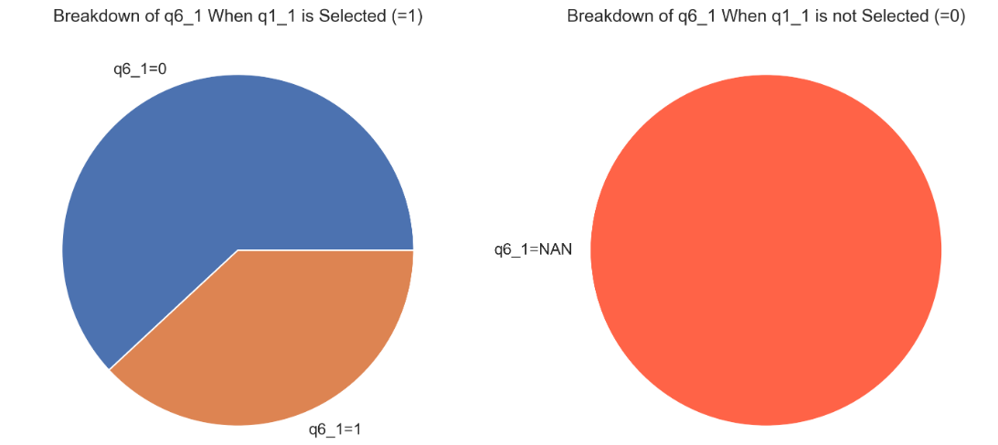
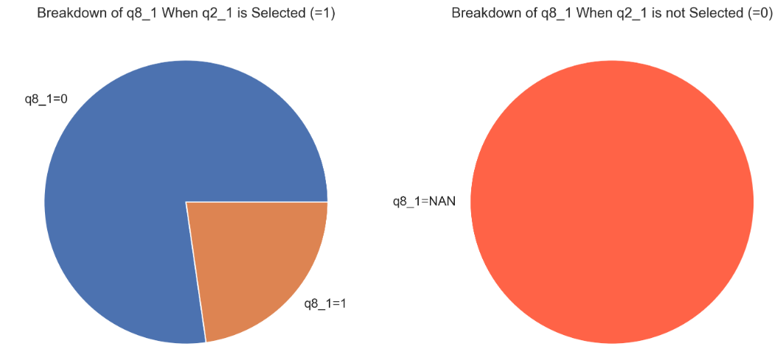
Task 3 Part 1 – Implementing Decision Tree Algorithm to Predict Question 5 (Pre-Processing) - 1
The Pre-Processing steps applied on our dataset were the following:
The Independent (Explanatory) and Dependent (Response) Variables in our dataset were identified and extracted:
Missing Values were identified
1. Initially it was identified that Question 6 had 882 missing values and Question 8 had 1365 missing values
2. Chi-Square test of independence was then used to check if number of missing entries in Questions 6 and 8 were dependent on some variable. P-value when comparing q1_1 and q2_2 to missingness in Question 6 and Question 8 respectively was 0 implying a strong association.
All Question 5 Options
All Other Variables
4

Slide 5
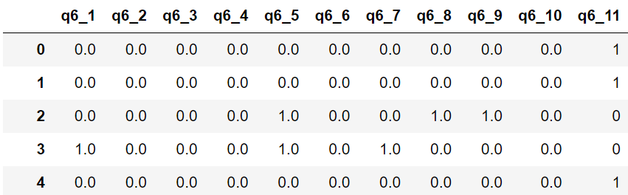
Task 3 Part 1 – Implementing Decision Tree Algorithm to Predict Question 5 (Pre-Processing) - 2
The Pre-Processing steps applied on our dataset were the following:
Missing Values were handled
1. Removing all missing entries in Question 6 and Question 8 would result in a significant loss of data.
2. For both Questions a new option was added entitled “q6_11” and “q8_11” respectively. These options are marked with “1” whenever data was previously missing (All other options are labelled 0).
3. q1_1 and q2_1 were removed as they are fully explained by these new options
5

Slide 6

Task 3 Part 1 – Implementing Decision Tree Algorithm to Predict Question 5 (Pre-Processing) - 3
The Pre-Processing steps applied on our dataset were the following:
5. Splitting Dataset
1. The dataset was split using train and test subsets.
6. Feature Selection
1. Forward Feature Selection was used to understand which features are relevant for our model.
6

Slide 7
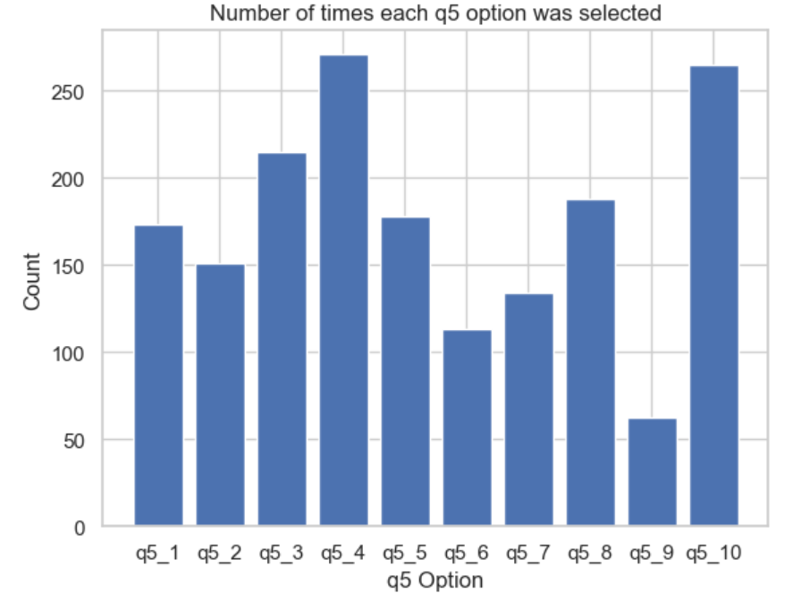
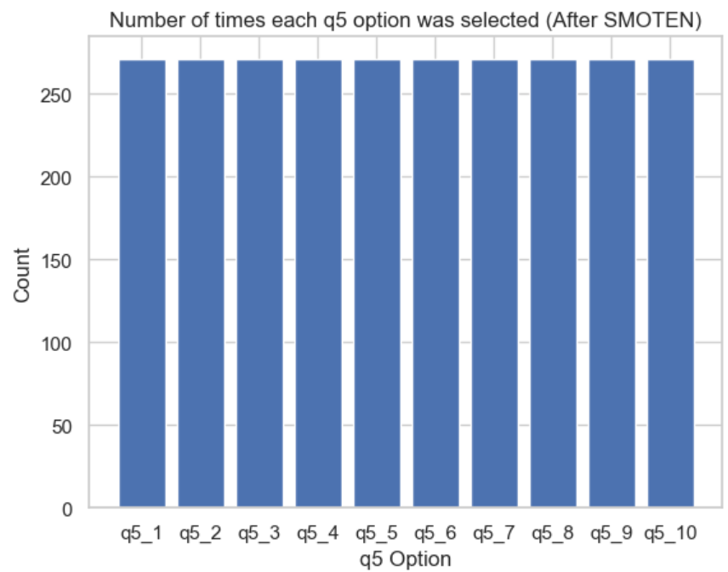
Task 3 Part 1 – Implementing Decision Tree Algorithm to Predict Question 5 (Pre-Processing) - 4
The Pre-Processing steps applied on our dataset were the following:
7. Data Imbalance
1. The distribution of responses for Question 5 was initially analysed to check for data imbalance.
2. This data imbalance was then adjusted using SMOTE-N (Synthetic Minority Over-Sampling Technique for Nominal Variables)
After SMOTE-N
7

Slide 8
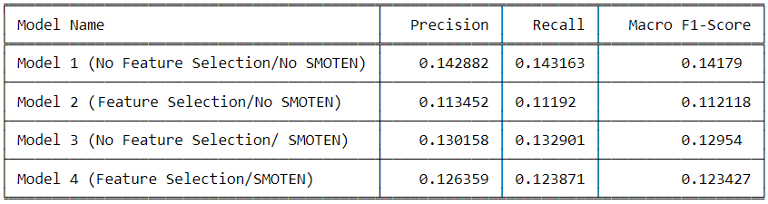
Task 3 Part 1 – Implementing Decision Tree Algorithm to Predict Question 5 (Application and Performance Metric Analysis)
To ensure the best possible final model is implement, the Decision Tree Algorithm was repeated four times with varying degrees of pre-processing applied to the dataset.
1. Model 1 - No feature selection and no SMOTE-N (Best Model according to all three performance metrics)
2. Model 2 – Feature selection applied but no SMOTE-N
3. Model 3 – SMOTE-N applied but no feature selection
4. Model 4 – Both feature selection and SMOTE-N applied
N.B: Grid Search Hyperparameter tuning was used to optimise the decision tree for each model.
8

Slide 9
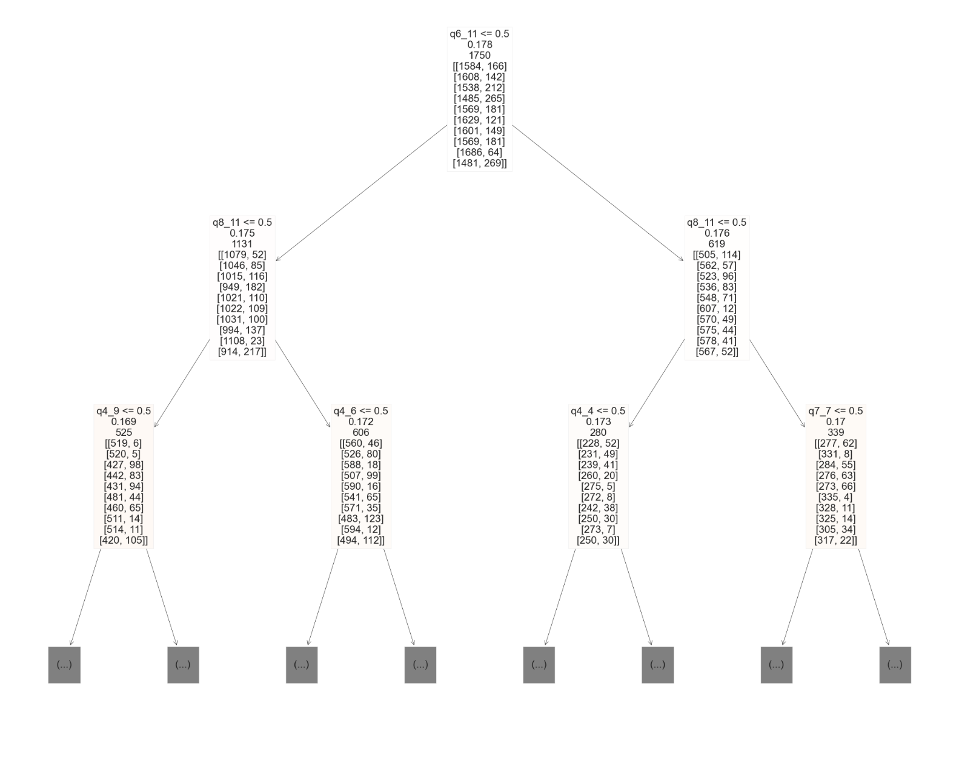
Task 3 Part 1 – Interpreting Decision Tree Algorithm
9

Slide 10
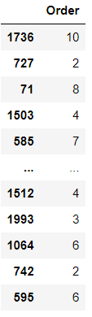
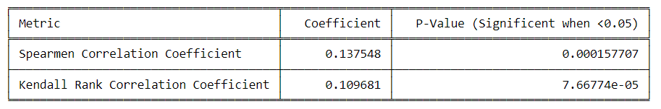
Task 3 Part 2 – Adjusting Decision Tree Algorithm to Predict Semantically Ordered Question 5
Since it is now known that Question 5 is semantically ordered, we can assign an integer value to each option.
In principal this should see an improvement in our Decision Tree Algorithm since previous form of Question 5 was inducing sparsity.
The Spearman Correlation Coefficient and Kendall Rank Correlation Coefficient were used to evaluate the performance of the model.
10

Slide 11
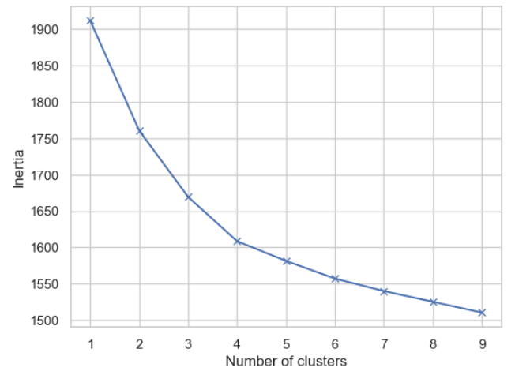
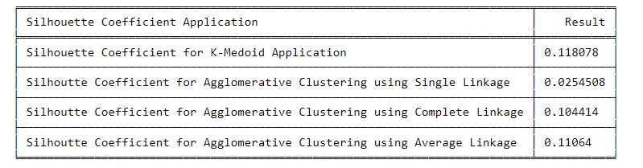
Task 4 - Identifying Similar Respondents (Clustering Algorithms)
Two Clustering Algorithms were implemented for our Dataset:
1. The K-Medoids Algorithm (K = 4 based on the elbow method)
1. Clusters are built in such a way that in each cluster the total sum of Jaccard distances between all points and some reference point (Medoid) is minimised.
2. Agglomerative Clustering (Repeated until a total of four clusters were obtained)
1. Each object is considered as a single cluster and the two closest clusters are merged based on their proximity calculated using the Jaccard distance. Three types of linkage criterions were utilised (Single, Complete and Average)
Silhouette Coefficient used to Identify best clustering method.
11

Slide 12
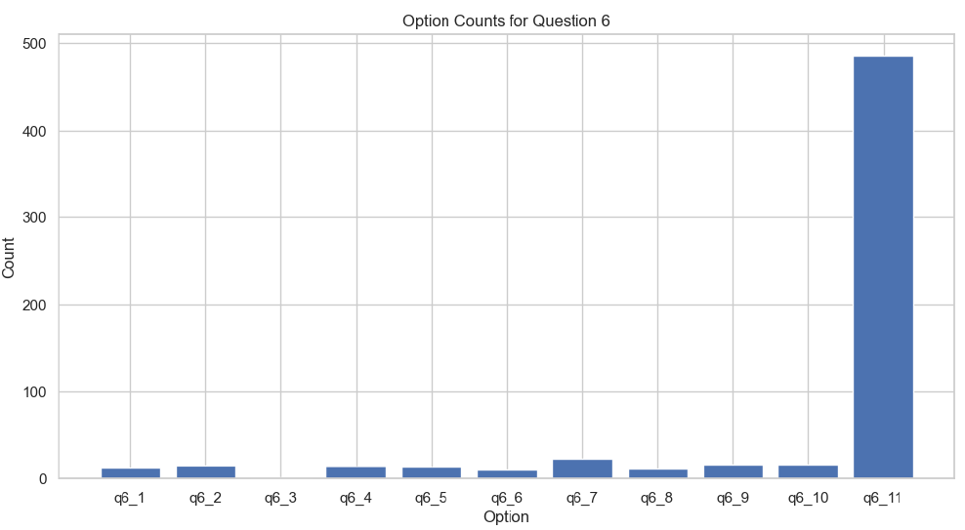
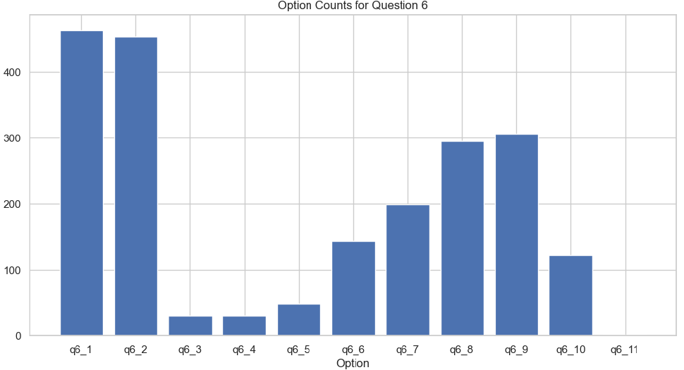
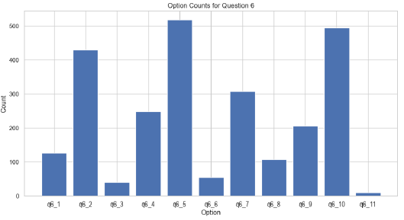
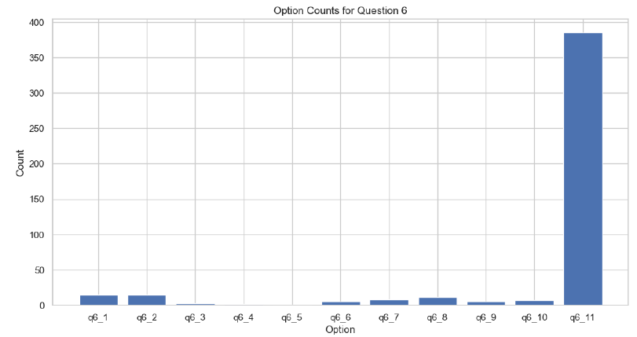
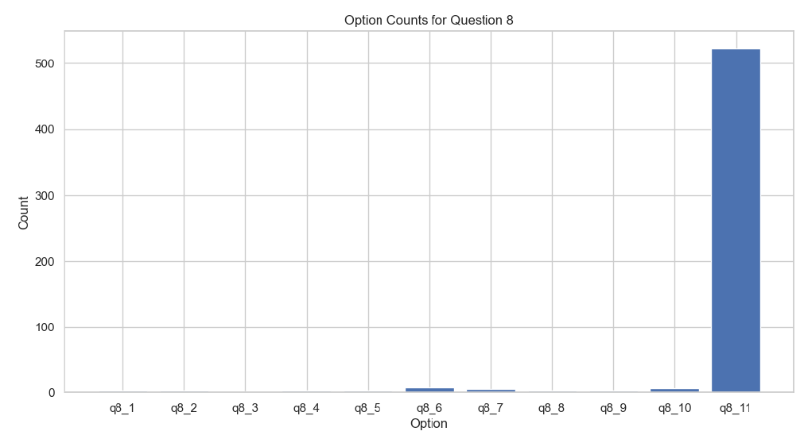
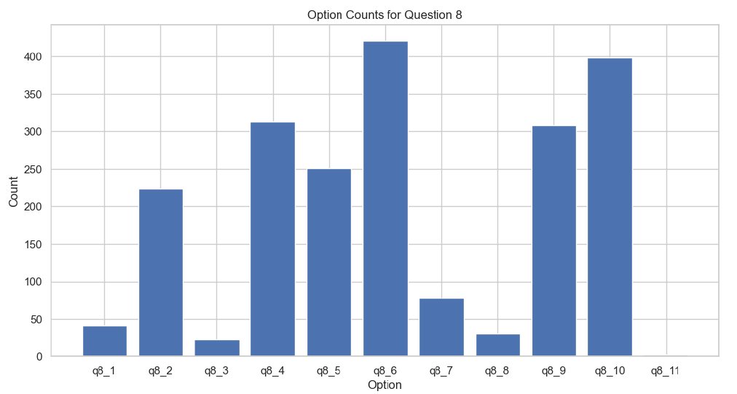
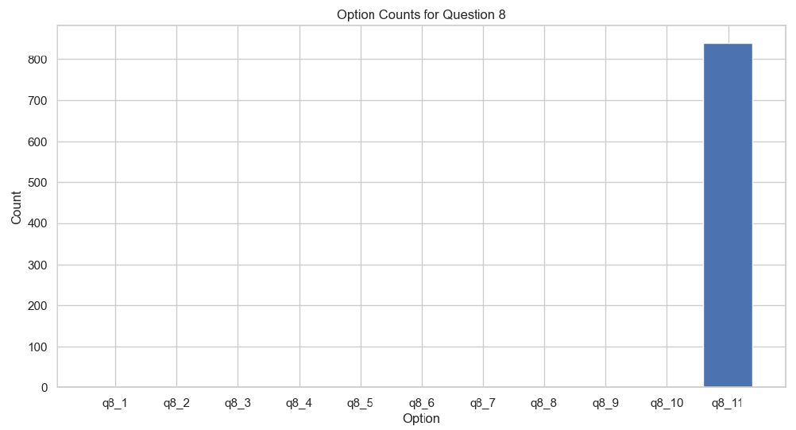
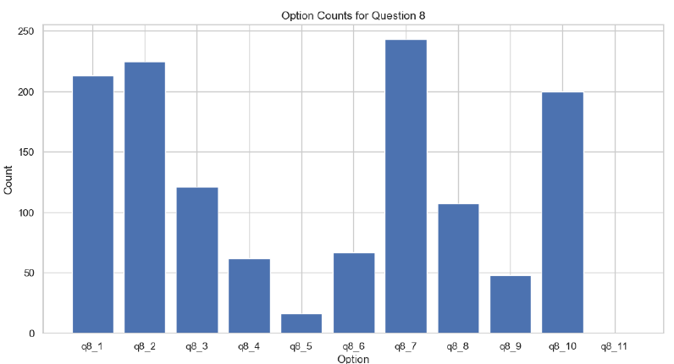
Task 4 - Identifying Similar Respondents (Describing Clusters)
A Bar Chart was used to analyse the groups identified The results obtained for questions 6 and 8 reveal distinct group differences
Group 1
Group 2
Group 3
Group 4
12

Slide 13
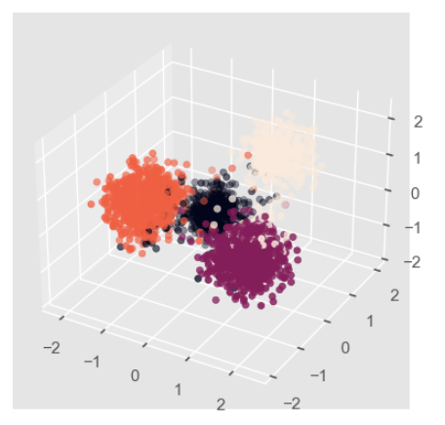


Task 4 - Identifying Similar Respondents (Visualisation & Assigning New Entry to Cluster)
To provide an example of assigning a new entry to a cluster we assumed we had a new respondent who filled in the survey as follows:
To assign this data point to a cluster:
1. Calculate Jaccard distance between new point and each of the 4 medoids
2. Assign data point to cluster of the medoid with lowest Jaccard distance
q2_1
q5_5
q8_9
q10_2
q3_2
q7_8
q9_2
q10_3
q4_3
q8_2
q9_3
q10_9
13

